Slide 1
Class Vs Interface Inheritance
Ryan and Jono

Slide 2
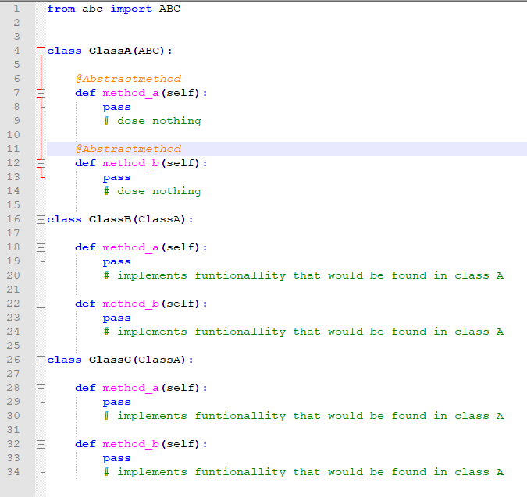
Interface Inheritance
What is it?
Interface inheritance is when a child class only inherits the description of behaviour from the base class and provides the implementation itself.

Slide 3
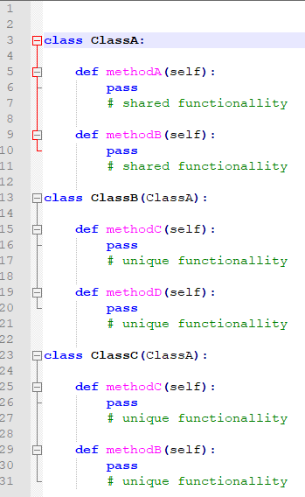
Class Inheritance
Class inheritance is basically just a mechanism for extending an application's functionality
by reusing functionality in parent classes. It lets you define a new kind of object rapidly in terms of an old one.
It lets you get new implementations almost for free, inheriting most of what you need from existing classes.

Slide 4
The Difference
It's also important to understand the difference between class inheritance and interface inheritance (or subtyping).
Class inheritance defines an object's implementation in terms of another object's implementation. In short, it's a mechanism for code and representation sharing.
In contrast, interface inheritance (or subtyping) describes when an object can be used in place of another.
Section 1.6 How Design Patterns Solve Design Problems, P16 - P17

Slide 5
Similarities
Key assumptions
Have the same relationship symbol in UML
In a large number of languages there implementation is almost the same e.g. python. Languages like C# and java have a different ways to implement them
Add your procedure here
Notes:
Because of languages implementing the two concepts the same way it can get confusing

Slide 6
When to use Interface Inheritance?
So why prefer interface inheritance to class inheritance?
The simple answer to this is to avoid coupling between two components of an application.

Slide 7
When to use Class inheritance
When 2 objects have some of the same functionality allows them to share it (it’s only written in one place easier to maintain) while still being able to have there unique functionality without knowing the other objects

